Slide 1


APSSDC- Edunet “Future Skills Program” CS
Final project : KEYLOGGER AND SECURITY
Done by : PENTAKOTA JYOTHIRMAI
Under the guidance of :VIGNESH.M

Slide 2
KEYLOGGER AND SECURITY

Slide 3
OUTLINE
Keylogger
Types of keylogger
Keylogger working
Protection from keylogger
End users of keylogger
Project link

Slide 4
KEYLOGGER
Definition : Keylogger is a malicious computer program that records everything you type on the keyboard, learns the keystroke pattern, including words, characters, and symbols, and sends all the recorded details to the malicious hackers.
Usernames , passwords ,and OTPs are vulnerable to adversaries logging your keystrokes.
Keylogging is accomplished by installing malicious software on a computer.
Best to ensure you are only logging onto devices to which you only have access.

Slide 5
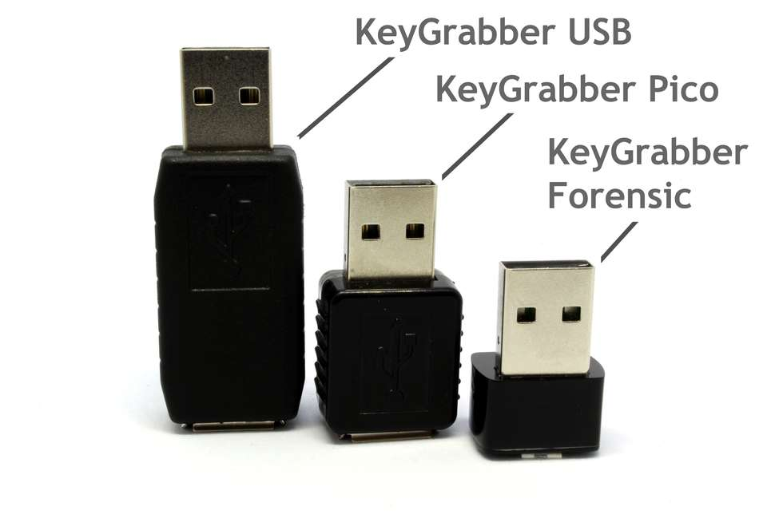
Type of Keyloggers
Hardware Keyloggers: Devices attached to our computer will act as a keylogger and collect information about the specified target.

Slide 6
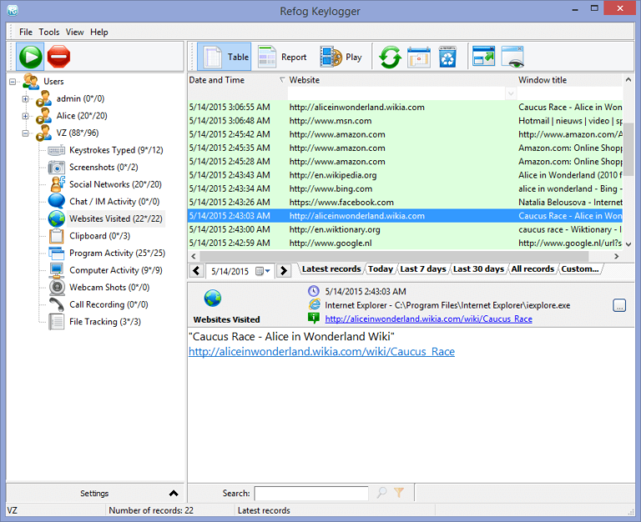
Software keyloggers: These are probably malicious programs that cannot infect your system but still steal your passwords, account details, etc.

Slide 7
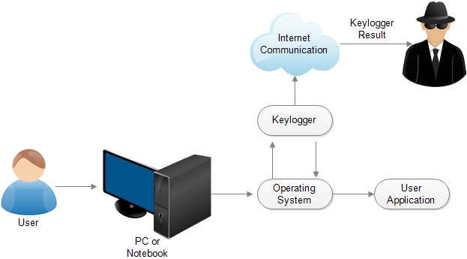
How does Keylogger work?
Just like any other malicious program that sends its reports to the attackers, keyloggers also send information about keystrokes that a victim enters in his/her keyboard to its creator or a remote server or a specified email address.
Keyloggers are hidden so deep that even some antivirus programs can’t detect them. Professionally designed keyloggers get embedded with the operating system kernel, making it too difficult to detect by antiviruses. Keyloggers are of the most dangerous and stealthy.

Slide 8
How to Protect From Keyloggers?
Do not download any attachments from unknown websites.
Keep your Antivirus software updated.
Use Virtual Keyboards, which will prevent typing keystrokes.
Use Two-Factor Authentication Methods on essential sites.
User firewall and password manager.

Slide 9
Who are the end users?
LEGAL KEYLOGGER USE: Consider the following examples of legal uses for keylogging software:
Parents might use a keylogger to monitor a child’s screen time.
Companies often use keylogger software as part of employee monitoring software to help track employee productivity.
Information technology departments can use keylogger software to troubleshoot issues on a device.
ILLEGAL KEYLOGGER USE: Consider the following examples of legal uses for keylogging software:
Identity theft
Stalking or voyeurism
Installation on a device owned by someone else

Slide 10
PROJECT OVERVIEW
The project is all about the key stokes you have entered in your keyboard are monitored by the end user with the help of a key logger code implemented on our system.
Here we are using python IDE for our code execution . To execute the code we need to install the pyp and Json libraries on your system in command prompt.
After the execution a window is appeared ,click on start and type some thing in your notepad then you can see the keystrokes you have entered in the keyboard in the program output created folders.

Slide 11
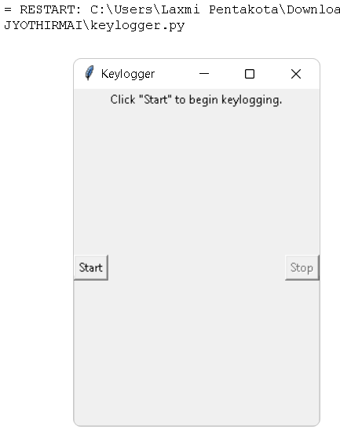
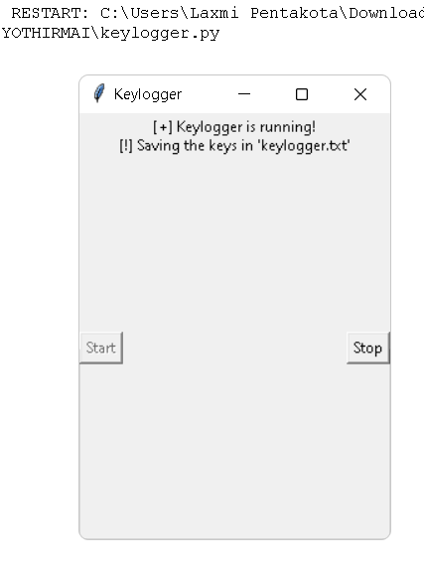

THE SOLUTION AND ITS PROPOSITION

Slide 12
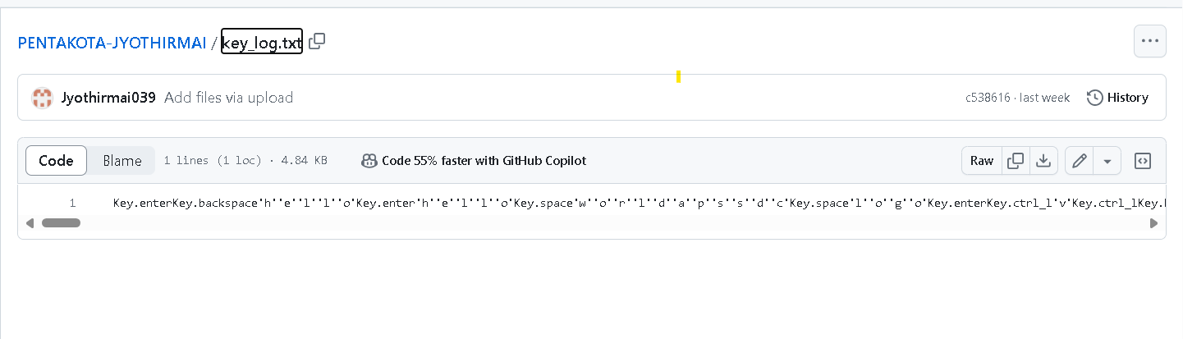
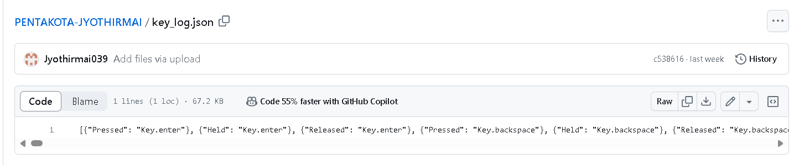
THE WOW IN OUR SOULTION

Slide 13
PROJECT LINK
https://github.com/Jyothirmai039/PENTAKOTA-JYOTHIRMAI.git

Slide 14
THANK YOU

